Slide 1
Project Management Lesson Learned Web Application
Initial Presentation
By: Joel Jacobson
KickOff Meeting for Project Initiation Phase and Planning Phase
April 19th, 2021

Slide 2
01
Project Overview
Agenda
07
Budget & Procurement
02
Stakeholder
08
Research Instruments & Methods to Analyze
03
Project Charter
09
Lesson Learned
04
Risk Assessment
10
Closing Summary
05
Project Scope
06
Project Schedule

Slide 3
01
Project Overview
Initiation

Slide 4
Project Phases
Initiation
Planning
Execution
Monitoring
& Controlling
Closure
Notes:
During this presentation I will be covering two phases (Initiation & Planning) combined which all their deliverables and milestones has been successfully completed.

Slide 5
Lesson Learned Background
History
Incorporation
Critical
Evolvement
Importance
Apply
Notes:
Lesson Learned has been discovered and running for decades, has been applied as passive or active.
It has been incorporated and part of the human being and their needs to get better or improve from past mistakes from our instincts.
Lessons learned are a critical and valuable area of knowledge to gather all inputs and feedback from stakeholders and project members involved in the project.
Lesson learned has evolved and is a vital source of information to improve business process and best practices.
Understand what went wrong and why.
Identify what can be done differently in the future.
Lesson Learned often being applied by Analyzing, Storing and Retrieving.

Slide 6
Project Focus
Focus: Web Application Base, Security and Accessibilities
Consolidation
Notes:
The main goal are represented into 3 areas of focus.
Web Based – not an installable software application. This evade the need of incompatible OS.
Security and Accessibilities – Documentation and Data will be controlled by Admin Roles and permissions.
Consolidation - (PMLLWA) serves to control and manage all project parts and lesson learned into one consolidate place.

Slide 7
Project Process Steps
Online Lesson Learned Application Research
Online Development Tools Research
Surveys Inquiries and Data Collection
Web Application for Lesson Learned Interface (Product)
Notes:
Step to follow to have a complete satisfactory product.
Online Tools Research - best approach of application requirements , best practices on selecting coding and presenting a web application.
Online LL Research – Dig into market application what it is being provided , how it is presented, and tools offer and reviews from users.
Survey – Results collected will be analyzed to refined deliverables to have successful criteria factors.
Product

Slide 8
Project Objective
Supportive
Time Reduction
Reduce residual or minimize risks
Documents Manageable
Customizable
Notes:
Support the project sponsor with a strategic plan to improve personal gain or business organizations' projects to access a bank of the lesson learned of all domains.
Will reduce the time associated with the consumption of resources needed and researching tools implementations.
It will enhance ongoing or future projects and reduce potential risk encounters.
Will provide sufficient data allowing projects access to a significant number of lessons learned from previous projects and the capability to manage and use project knowledge for project documentation.
Do not have an end goal. Expansion of this product will allow the growth of simplifying customer needs and adjustment.

Slide 9
Current Situation
Technology fast pace incorporation
Outdated templates, tools and non-practical usage of lesson learned into projects
Notes:
Technology System are moving on a fast pace which all instruments evolves within the systems.
This technologies will facilitate with rapid tools of needs to be used.
It will provide all resources needed in one place without the need of going different places.
Today it still been used outdated template such as word or excel templates to be used for projects.
This version might update and if macros or formulas is been used in place later must be updated and takes time and effort.
You want to prevent troubleshooting this templates and readjusting layout.

Slide 10
02
Stakeholder
Identification

Slide 11
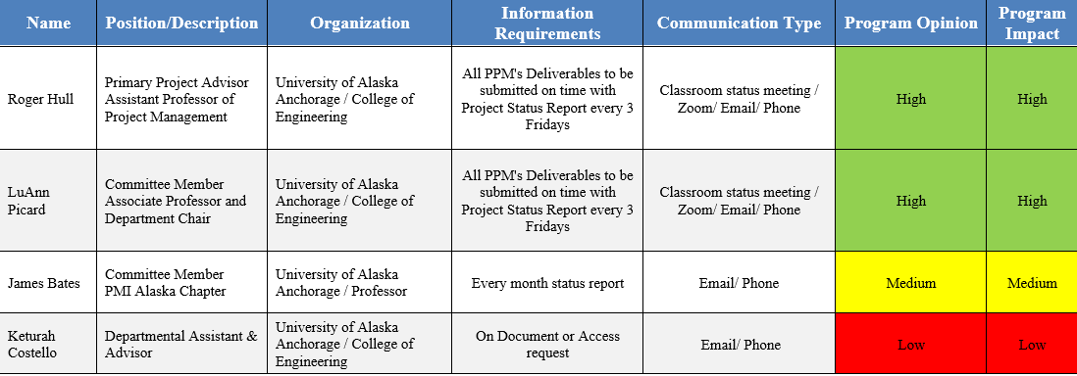
Internal Stakeholder
Notes:
Internal Stakeholder:
Name
Role in Project
Information Requirements
Communication Type if needed

Slide 12
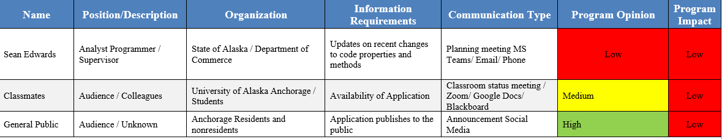
External Stakeholder
Notes:
External Stakeholder:
Name
Role in Project
Information Requirements
Communication Type if needed

Slide 13
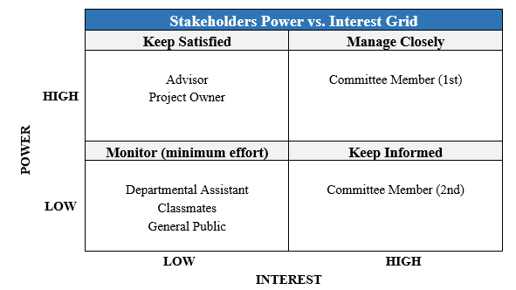
Power Grid vs Interest
Notes:
Naming are the Role or Position within this project that was identified on the Stakeholder Register

Slide 14
02
Project Charter
Approval

Slide 15
Project Charter
Identified:
Project Description
Project Sponsor
Project Key Stakeholder
Project Mission / Purpose
Project Milestone / Schedule
Project Preliminary Budget
Project Agreement
Signed by Project Sponsor:
1/16/21
Project Initiator
Sponsor
Contacts
Project Stakeholder
Business Case
Develop
Project
Charter
Develop Project
Management
Plan
Enterprise
Organization
Project
Documents
Org Process
Enterprise Factors
Subsidiary
Management
Plans (9)
Collect
Requirements
Close Project or
Phases
Notes:
Starting the Project:
Project Selection took a new route and effort on switching from an Organizational Project to an Independent Project.
Original Contacts wasn’t available.
Business Case – was a Long-term project.
PMBOK Guide 5th Edition & 6th Edition

Slide 16
Project Priority Matrix
Time
Performance
Cost
Constraint
Enhanced
Accept
Notes:
Constraint:
Time – based on 2 part in a year, needs to meet timeframe
Performance – there is a bit of room to modify or add / remove deliverables.
Cost – Budged can exceed the expected limit but won’t be hurting the success of the project.

Slide 17
04
Risk Assessment
Identify, Analysis and Implementation

Slide 18
Risk Analysis
The Following table show the Metrics used to measure the risk and opportunities that had arrived during the Initiation and Planning Phases capture.
Qualitative Risk Analysis Metrics
Rating | Probability | Description
1 | Very Low | High unlikely to occur.
2 | Low | Most likely will not occur
3 | Moderate | Possible to occur.
4 | High | Likely to occur.
5 | Very High | Highly likely to occur.
Rating | Impact | Project Duration
1 | Very Low | No change in project timeline
2 | Low | < 5% Increase in project timeline
3 | Moderate | 11-15% Increase in project timeline
4 | High | 16-20% Increase in project timeline
5 | Very High | > 20% Increase in project timeline
1 – 8.9
9 – 16
17 - 25
Notes:
Probability and Impact as measures in a scale from 1 – 5 rating.
Both rating will be multiplied. Ex. 3 x 2 = 6
6 is the risk level.
Risk level is monitored in 3 areas, green ,yellow and red.
This area will be utilized during Mitigation to bring down the final risk level after a risk response plan is set in place.

Slide 19
Risk Analysis
Risk Map
Likelihood | 5 | High Chance
 | 4 | Almost certain |  |  | Unlicensed Software | Hardware Performance
 | 3 | Certain |  | Data Bandwidth |  |  | Insufficient Data Collection
 | 2 | Likely | Hosting Site Maintenance
 | 1 | Not Likely |  |  | Services Low cost
 |  |  | 1- Insignificant | 2 - Low | 3 - Medium | 4 - High | 5 - High
 |  |  | Impact
Notes:
6 identified items and logged into risk register
5 Possible Risks Identified.
1 Opportunity Identified.
All Risks Level has been evaluated with a Response Type, after implementation with a plan of action, Risk Levels minimized.
Hardware Performance has been identified with the highest risk level.
Colors represent the risk level after balanced with risk responses and mitigation method.

Slide 20
05
Project Scope
In Scope / Out of Scope

Slide 21
Deliverables
In Scope:
Requirement Definition
Structure, Logic & Layout Design.
Market Buyout Product
Software Selection
Security
Out of Scope:
Gold Plating
Additional Cost
Additional Computer
Additional Manpower
Notes:
In Scope:
Project & Product Requirements Definition.
Documentation Flow for project documentation quality
Product documentation which will produce an application
Structure, Logic & Layout Design.
Hosting storage location & Domain Name.
Program language, Database Type.
Security Implementation.
Out of Scope:
Expand or add additional content to the application.
Cost of additional Software and Hardware.
Additional Computer System other than personal system.
Additional Manpower other than the project manager.

Slide 22
Deliverables: Project Requirements
Project Charter
Research
Project Documentation Requirements
Construction of Documents
Analysis Tools
Organization Structure
Lesson Learned
Notes:
Main components required to make a product successful
Startup of a project Charter will open-up Initiation and planning phases and the development plans for the remaining phases.
Tools used to gather valuable data for project documents like Risk Register, Pert + Analysis, Stakeholder Analysis and Register.
Compile and Organized all project document on an easy manner way to track all required and completed files.
Research of collected data or feedback to be used to evaluate on how process will follow alongside with all phases during project schedule.
All template as baseline to be used for all written documents.
Lesson Learned are vital for all section of the project, this will be helpful to not fall behind on status and the health of the project. Everything must be logged.

Slide 23
Deliverables: Application Requirements
Database
Templates
Project Application Requirements
Design
Manual
Hosting
Security
Notes:
Database: Schema which stores all data received by the users.
Define structure and tables of the database
Design Relationship of tables in the database
Look and Feel: Design a professional layout for the web application for the users to navigate
Layout design should include a small logo professional with dark or grey colors
Hosting/Domain: Location where all files and web application will live
Define space and naming convention needed for the PMLLWA
Lesson Learned Templates: Useful templates related to all lesson learned
Design all templated that majority of projects uses
Templates for MS Word and Excel
Manual for User: Provide and guide user on how to use the PMLLWA
PDF formats write out with visual images of all areas used in this project
Security: Site and web content will be secure by authentication.
Login/Register system
User roles

Slide 24
06
Project Schedule
WBS and Timeline

Slide 25
WBS
Notes:
Overview of Project Deliverables and Milestones
Covering 2 Phases:
Initiation and Planning Phase
Initiation: Project Requirement (Documentation)
Planning: System Requirement for Developing a product
Project Product it is straightforward to produce.
Risk Responses are shown on WBS.

Slide 26
WBS
Notes:
Long-Term events during Fall 2021
Execution
Monitor & Control
Closeout

Slide 27
Project Timeline Summary
Initiation Phase
1/17/21 – 3/12/21
Planning Phase
2/28/21 – 4/19/21
1/17/21 – 2/1/21 Project Requirements
2/2/21 – 3/12/21 Project Plan
2/28/21 – 3/11/21 Gather System/Layout Requirements
3/11/21 – 4/15/21 Design
Project Start
Project Finish
January ‘21
February ‘21
March ‘21
April ‘21
1/29/21
1st Status Report
2/5/21
2nd Status Report
3/26/21
3rd Status Report
4/19/21
Final Status Report
Notes:
Timeline:
2 Phases: include Milestone / Deliverable Summary

Slide 28
Project Timeline Forecast
Execution Phase
8/18/21 – 10/21/21
Monitoring & Control and Closeout Phase
10/22/21 – 12/3/21
Buffer
12/3/21 – 12/17/21
8/18/21 – 10/5/21 Deploy
10/6/21 – 10/15/21 Troubleshooting
10/15/21 – 10/19/21 Writeups
10/19/21 – 10/21/21 Code Review
10/19/21 – 10/21/21 Code Review
10/22/21 – 10/29/21 Monitoring
10/30/21 – 12/3/21 Closeout
Project Start
Project Finish
August ‘21
September ‘21
October ‘21
November ‘21
December ‘21
Notes:
Timeline: Long-Term Fall 2021
3 Phases: include Milestone / Deliverable Summary
Monitoring and Closeout is represented as merge for display purpose
Project Buffer

Slide 29
Project Milestones
Notes:
Focuses Milestone to be completed to prevent critical tasks or delay in project schedule before Initiation and Planning Phase closure.

Slide 30
Schedule Analysis
Duration ( Days) | Optimistic Duration | Pessimistic Duration | (op + 4*mo + pe)/6) Expected Duration (tE) | Standard Deviation | (-2) Expected Duration (tE) @5% | (-1) Expected Duration (tE) @16% | (-.5) Expected Duration (tE) @25% | (0) Expected Duration (tE) @50% | (1) Expected Duration (tE) @84% | (2) Expected Duration (tE) @93% | (3) Expected Duration (tE) @98% | Project Buffer ((tE)*12.5%/ 3
229.00 | 208.18 | 254.44 | 229.77 | 7.71 | 214.35 | 222.06 | 225.92 | 229.77 | 237.48 | 241.34 | 245.73 | 9.57
$ 147.00 | $ 133.64 | $ 163.33 | $ 147.49 | $ 4.95 | $ 137.60 | $ 142.55 | $ 145.02 | $ 147.49 | $ 152.44 | $ 157.39 | $ 162.34 | $ 18.44
229.00 | 208.18 | 254.44 | 229.77 | 7.71 | 214.35 | 222.06 | 225.92 | 229.77 | 237.48 | 241.34 | 245.73 | 9.57
0.98 | NORMAL DISTRIBUTION (Z) |  |  | 239.00 | Projected Estimated Duration
Notes:
Type: Fix Work – 3 hrs. per working calendar days (Mon – Fri)
Resource: 1 personnel – Project Manager / Analyst Programmer
Project Timeframe: 1/18/2021 – 12/3/202
Buffer Duration: 12.5% of the project duration as Fix Duration
Buffer Budget: difference between Expected Duration (Mean) and Pessimistic Duration
Expected duration projected to 239 days.

Slide 31
Change Request Process
Apply
System Changes
Details for Change Request
Impact Analysis
Area of Impact (ex. Schedule, Scope, Cost, etc.)
Whose Decision (Approve, Denied, Refer, Modifications, etc.)
Justification
Risk Association
Schedule Gantt Adjustment
Documentation to Update
Approval
Review by Project
Sponsor / Advisor
Submit System Change Request
Notes:
Change request process will be standard for all process: System, documentations, tools, requirements etc.
Capture Input log for Change Request from 5 sections.
Apply updates, baseline, implementation on where adjustments are need from new changes.

Slide 32
07
Budget & Procurement

Slide 33
Budget Market: Product
Max Cap Expected: $165
Hosting: $106
Domain: $12
SSL Cert: $29
Total: $147
Optimistic (Deals) Products:
Hosting: $99
Domain: $9
SSL Cert: $22
Total: $130
Risk Identified (low) Pessimistic:
Unlicensed Software: ~$200
Notes:
Constraint: Max Cap Allowed: $500
$147 : Budget usage up to project Initiation & Planning closure

Slide 34
Budget Market
Make/Buy Decision Analyst (Site Development)
WBS | Task Name | Self-Perform / Sub-Out | Justification
2 | Planning | Self-Perform | Budget constraint
2.1.6 | Program Language Selection | Self-Perform | Personal Experience
2.1.7 | Hosting Space | Sub-Out | Spacing needed from outsource
2.1.7 | Domain Name | Sub-Out | Domain has been controller by outsource
2.2.1 | Database Structure | Sub-Out | Storage of Database part of Hosting
2.2.6 | Security | Self-Performed | Personal Experience
2.2.2 | Layout Design | Self-Performed | Personal Experience
2.1.1 | Hardware | Self-Performed | Own Computer
2.1.4 | Software | Self-Performed | Free Editions
Notes:
C# language part of visual studio community center which is offer as free edition
Setup agreement to purchase space to host all files for the web application. This space contain tools needed to monitor data, access, and bandwidth
Proper name assigned to the project to users be able to access to the web application with a friendly name. Domain names need to be linked with Host.
Microsoft SQL Server will be used to store all data collected from lesson learned.
Security Measures will be developed to contain the information input by the user with access restrictions.
Layout will be developed using Model, View & Controller (MVC) structure to merge desktop and mobile layouts using visual studio.NET
New computer system won't be purchase to high performance to develop this application. Normal Personal computer will be used instead. Inspected will be ran to make sure minimum requirements are met.
No licenses will be purchase during the development of this project. All software utilized will be from free editions.

Slide 35
Budget Market
Notes:
Self-Developed
Experience: Customer Service. Graphic user interface, accessibility
Price: product cost
Productivity: How stable are, based on product quality and quantitative and users' inputs on maintenance
Rating: Review by users
Proposal Merit: Product offer (bundle)
Ex. 4 x .35 = 1.4
Add up all values from same column.
Highest score

Slide 36
08
Research Instruments & Methods to Analyze
The Source

Slide 37
Research Instruments & Methods to Analyze
Research Methods
Research Instruments
Research Approach
Research Analysis
Notes:
Research Methods:
Online Articles, Personal & Work Experience and Survey Questionnaire
Research Instruments:
Online Reviews from Users feedbacks based on insight to compare against each other software like the one for this project. Demo test for few application that had the availability.
Research Approach:
Based on analysis and gather questions to answers myself. Questionnaire was produced and 10 questions were generated with 3-5 option of selection.
Surveys will be sent out throughout social media to a specific professional audience on the related career field for accurate data.
Research Analysis:
Articles, Surveys and Instruments results will be dropped into multiple tables to analyze then into different categories of metadata. Analytical Graphics bars will be produced, and analysis will determine what will be needed or recommended as part of the project. This data will be verified with all Focus area highlighted on Project milestone Deliverables.

Slide 38
09
Lessons Learned
What went bad or good

Slide 39
Lesson Learned
Lesson Learned PPM1:
Time limit assigned per day.
Lesson Learned PPM3:
Risk implemented in Project Schedule (Microsoft Projects).
Project Lesson Learned:
Measuring the complexity of the Project I picked.
Lesson Learned PPM2:
Consistency of Project Title, Description, Scope and Purpose Info across all files.
Class PPM’s Deliverables Lesson Learned:
Dedication too much time on Re-adjusting excel and word documents templates for my current PPM’s deliverables.
Lesson Learned PPM3:
Implement Research to the Project at the starting of the project lifecycle.
Lesson Learned PPM3:
Project Schedule Calendar and Duration Type.
Lesson Learned PPM4:
Rework of PMP documents files

Slide 40
10
Closing Summary
Notes:
Project Schedule will be baselined right after this last status briefing.
Project Manager/Sponsor will be closely working with Stakeholders for acceptance criteria during execution phase.
Project Scope: For Change Request only exclusion of project work packages will be acceptable or Risk Mitigation.
Project Timeout will be set during Summertime May – July.
Project Resources will incorporate an outside manpower for document reviews.
Risk Analysis: Risk will be evaluated and annotated before starting project execution phase. Will be reported to Project Stakeholders.
Project Cost: Will remain the same as will cover the duration of the year. Low risk and adjustment to the budget.
Documentation will be reorganized to be process on a different way before starting Project Execution.
Project Measurement will be focus on Time Management (SPI) and % of deliverables completed.
Time Constraint still a critical area to not let hang.

Slide 41
THANKS!
Any questions regards to the project presentation?

