Slide 1
Project Management Lesson Learned Web Application
Final Presentation By: Joel Jacobson
Capstone Project 686B December 2nd, 2021

Slide 2
01
Introduction
Agenda
07
Recommendations
Project Overview
Lessons Learned
02
08
Project Scope
09
Conclusion
03
04
Project Research
05
Project Product
06
Success Factors
1

Slide 3
01
Introduction
2

Slide 4
Introduction
Personal Goals
Background in Programming
Work Environment
Hobbies and passion in web development
Academic Goals
Fulfill the academic criteria based on project selection.
Based on project completion how it gave back to the PMBOK.
3
Notes:
Personal Goals:
Before Graduating with a B.S. Computer Sciences 2008, I developed small standalone apps for personal needs and friend's needs including helping improve the development process at my previous job as data entry.
Currently I work in the federal sector as an Air National Guard member as Operation Management under Cyber Defense and get to see the workflow being processed during exercises and mission sets. At my current State employment as an Analyst-Programmer, I get the chance to work on assigned projects towards many stakeholders under the same department.
I have a passion to continuing developing tools to improve the workforce environment or personal projects to speed up steps without the need or reworks.
Academic Goals
Able to complete my graduate-level from all acceptance criteria from my stakeholder at the end of the product produced.
Able to have a grasp on the understanding of the concept of all knowledge areas during its project lifecycle and how it is break down into 5 phases and what consist each phases. Increase my skills and abilities to improve future projects and treat projects on the proper procedure from a new standpoint after a full study on PMBOK.

Slide 5
02
Project Overview
4

Slide 6
Project Background
Selected project domain.
When did selected project initiated
Improve Initial and Planning Phases
Growth in Risk Analysis
Motivation to build own business for developing web applications
5
Notes:
The selected project (Project Management Lesson Learned Web Application) involve Information Technology and Software development domains. This is a domain which I am familiarized and had experience with. This type of project will be expedited during the execution phase which has the heaviest area for work to be done.
The selected project was based on not being able to execute a real assigned state project (wasn’t a realistic timeframe to have it completed by the deadline). I didn’t have anything set in stone that I wanted to do and presented for my project capstone until right before Capstone 686A. Had about 3 weeks in the project capstone when selected this PMLLWA. Had to move in purpose. Had to take into consideration that summer timeframe I’m traveling and needed a project that I can work on the go.
In the past I was lacking on initial and planning phases for any small project conducted: this could be Car Upgrades or Home Improvements. I used to jump directly into the execution phase.
I wanted to be able to minimize risks and roadblocks along the way during running a personal or professional project.
While I was thinking about the selection of my project, I took into consideration this could be a potential increase towards my passion for growing more into the programming world and potentially creating my application to distribute as a long-term goal.

Slide 7
Project Overview (PMLLWA)
Situation
Finding lessons learned documents or templates
Looking back archived projects lesson learned
Process of gathering valuable data
How to minimize workload process
Centralized location of documents
Project Solution
Standardized location for lessons learned
6
Notes:
For every project, no matter how big or small we will be applying and writing lesson narratives, logs, checklists, team feedback and templates across the project lifecycle. Whenever we start to think about a new project to prepare or an ongoing project, we think which documents is needed to bring over to be helpful.
Finding a good template online or a previous used template can be difficult at times to search for. Some of these templates might contain dummy data that has to be cleaned before using them.
Looking back to historical data from lessons learned can be tricky depending on the location they are stored: emails, papers, external drive, DVD/CD, etc.
Once you can find the appropriate documents needed and templates from the previous project then the process move to tailoring these templates to your project and cleaning up this project's lesson learned data to be exported into the new project assigned.
These previous lessons learned will help us with a similar project to be planned and executed. If there is no previous written lesson learned, we can fall into the same flaws from past issues or mistakes.
Having all lesson learned in one central location, we can have multiples team members doing research on these lessons learned at the same time.
By having the same layout formatting is easy to export the data into new documents for new projects.
The project will be more successful by standardizing project documentation and archived file’s location.
Team members will know where to go to find any lesson learned needed for any future projects.

Slide 8
03
Project Scope
7

Slide 9
Scope Assumptions
Application developed utilizing free sources of applications tools
Hosting & Domain name provider
Budget within constraint
No Additional resources (manning) to the project
Enough data collection from research
Project Time accommodation within project timeline
PM will set appropriate time during project lifecycle
8
Notes:
Application Used for Development:
Visual Studio Community Edition 2019,
SQL Server Management Studio (SSMS for database mgmt.)
Microsoft Word and Excel (templates) School License Edition
Hosting and domain:
MyASP.Net – Bundle package (file system, database, domain name)
All Project Phases, Milestones and down to the work packages was ran and executed by the Project Manager: Joel Jacobson
During Research for Interviews, Tools Tested Reviews and Surveys Reviews enough data will be collected for the success criteria on the deliverables of the product.
This project timeframe will be within project capstone phases A and B. Summer timeframe will take a break on project execution phase.

Slide 10
Project Deliverables
Security
Web Application Base
Lessons Learned Templates
Accessibility & Flexibility
Consolidation
9
Notes:
Project Deliverables are presented into 5 areas of focus.
Security - Documentation, and Data will be controlled by Admin Roles and permissions.
Data Stored in Database
Web-Based – not an installable software application. This evades the need for an incompatible OS.
A public domain name and hosting space service included.
Accessibilities & Flexibility – able to access the application remotely, mobile, or any device that has access to a browser.
Consolidation - (PMLLWA) serves to control and manage all project parts and lessons learned into one consolidated place.
Lessons Learned Templates – Default Standard Templates provided to download and open for customization.

Slide 11
Project Contraint Matrix
Time
Performance
Cost
Constraint
Deadline: Dec. 3rd, 2021
Enhanced
Necessary Fields needed based on Research Analysis
Accept
Online Services: ~ $500
10
Notes:
Constraint:
Time – based on 2 parts in a year, needs to meet the timeframe
Performance – there is a bit of room to modify or add/remove deliverables.
Cost – Budget can exceed the expected limit but won’t be hurting the success of the project.

Slide 12
04
Project Knowledge Areas
11

Slide 13
Project Knowledge Areas
Schedule Management
Scope Management
Cost Management
Risk Management
12
Notes:
KA:
Scope, Schedule and Risk Management: Only by Initiation and Planning Phase
Cost Management: during execution, Monitoring and control and Closeout phase

Slide 14
Project Knowledge Areas
Scope Management
Schedule Management
Reinforce Scope statement
Prevent addition work to what’s in scope
Challenges on schedule
Changes Request
Risk Occurrence Adjustment
13
Notes:
Scope:
I will be reinforcing this area; this project is in IT domain, this type of project it can incur dynamically changes while on the execution phase.
I needed to focus on the definition of all details in the Scope Statement as technology systems change with a fast pace and requirements.
I developed the Scope Statement plan highlighting all deliverables down to their respective tasks including milestones.
Will include what is in scope and what is out of the scope and keep this beside my computer systems which will remind me of not doing gold platting (doing additional changes without a system change request).
Schedule:
It is crucial when it comes down to the timeframe based on this project as part of the capstone project. This will help me on what to target specialty on connecting task relationship with other sequential tasks.
I needed to monitor closely the planning phase of this project which will consume the evening and weekends days as part of one of my constrain.

Slide 15
Project Knowledge Areas
Risk Management
Cost Management
Risk Identification
Reduce residual or minimize risks
Risk Acceptance with contingency plan
Systems and services needed
Personal Budget used
14
Notes:
Risk:
Provided enough risk analysis tied into work packages that can occur positive and negative items to be activated during any time of the project lifecycle.
I need to be able to how to mitigate risk responses based on the risk's identification based on the original plan.
Most of the risk was accepted, and a contingency plan was set in place to manage time consumption towards the project timeline.
Cost:
This will help the project to prevent additional cost or extension of equipment needed for the capstone initiation and planning phases duration.
Focusing on cost management I can adjust the project based on how this project is funded and the limitations of the funding for specific items.

Slide 16
05
Project Research
15

Slide 17
Project Research
Literature Review (Details on the process for applying lesson learned)
Online & Offline Applications Review
Used 2 online apps, 2 offline apps
5 SMEs Interview work colleagues
Survey Questionnaire (10 Questions)
16
Notes:
Literature Review:
Online Project Management Institute Library Conference Papers, categorized by Lesson Learned
Online & Offline Tools Research:
Dived into the User's feedback review on both online apps.
Demo-tested Secutor Solution (Lesson Learned Database) and LessonFlow apps. Need demo request and takes time.
Microsoft Products, Word and Excel are the main platforms used by users to build lessons learned.
Five Subject Matter Expert Interview:
I Sat down with 5 selected colleagues to discuss ways of improving projects files and lessons learned collected from all team members during the project lifecycle.
3 from State Employee and 2 from Air Guard Employees
Found flaws that all 5 identify of having a physical file system to store files and documents of the projects and how hard it gets with time on going back looking the previous lesson learned.
Survey Questionnaire Development Results:
Survey built based on Literature, Applications, and Interviews Reviews. I produced 10 questions targeting the importance of lessons learned and the usage of building lesson learned templates, logs, checklists, and narratives. Sent out to a selected group of professionals within the same domain that I work for (IT) and had in return 29 respondents. These results were dropped into multiple tables and analyzed into different categories of metadata. Analytical Graphics bars were produced, and analysis was determined what was needed or recommended as part of the project. This data was verified with all Focus areas highlighted on Project milestone Deliverables.

Slide 18
05
Project Product
17

Slide 19
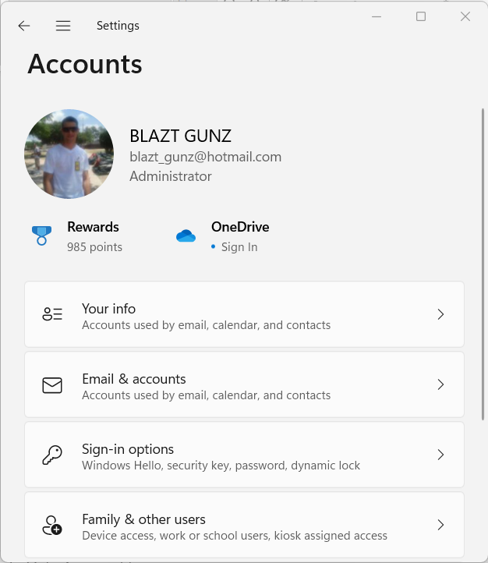
Improve from
Access to computer systems (Authentication)
Files or documents locked with password.
Commonly used tools such as MS Teams, OneDrive and Google Drive.
Trouble Ticket for Request access.
Virtual Private Network (VPN)
Security
18
Notes:
As new employees, we need to request access to certain areas
Sometimes a security measure is to lock files or directories behind a password.
3rd party applications are commonly used to consolidate files like Google Drive and Microsoft Teams.
Most organizations used tracking systems to track all trouble tickets. This work order can take time.
Working from home? Access over VPN to the organization Network.

Slide 20
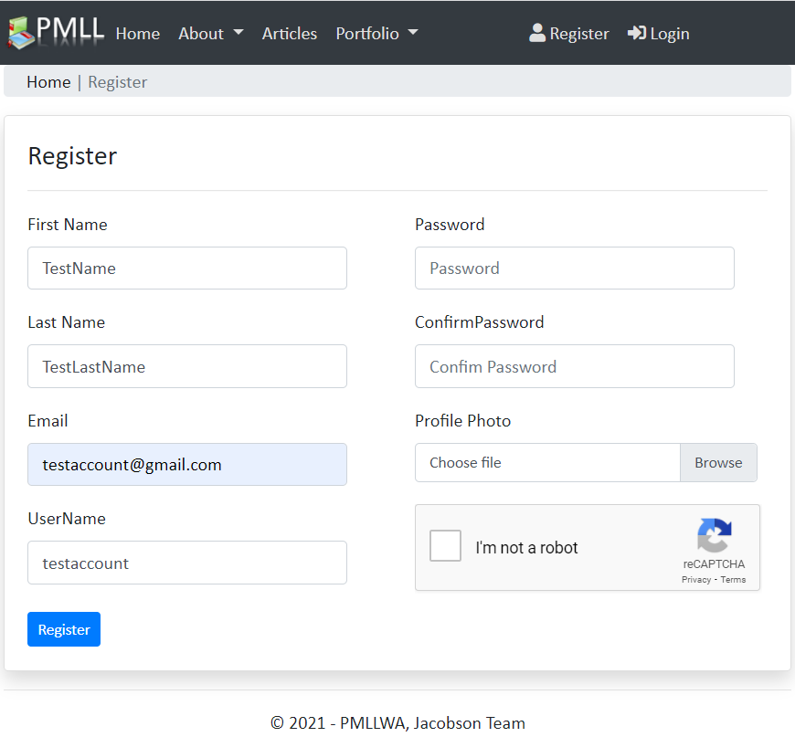
New feature
Limitless Account to be created.
Account will be used to track logs, projects files and project feedback.
Profile tied in with your job title, and role in the project assigned.
Security
19
Notes:
X number of accounts can be registered and managed on one screen. No IT background experience is needed.
For security, new and modified data will be tracked by username, date, and time.
The profile can be updated to show member roles on the projects.

Slide 21
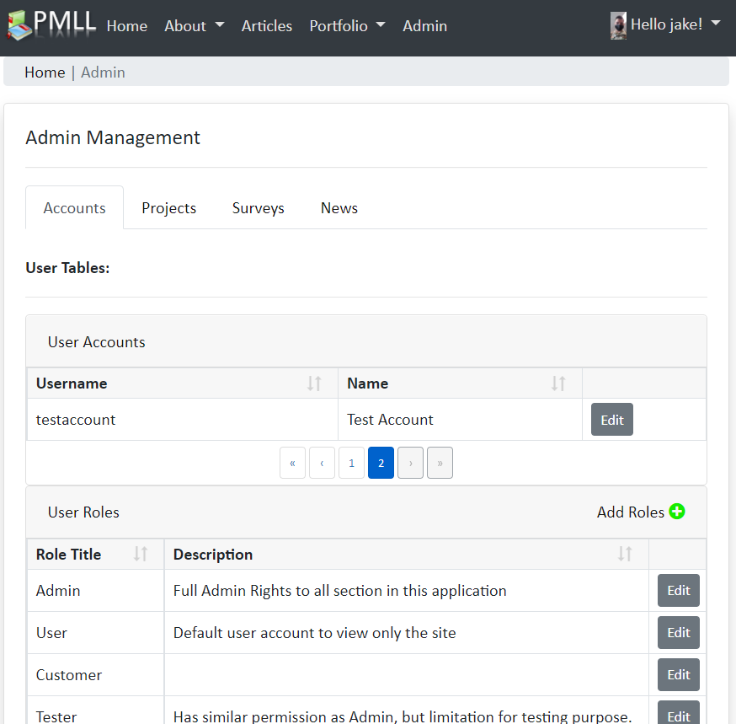
New feature
Registered Users have restriction based on roles.
Roles are assigned by PMO or Web App admin.
Admin Panel will be enabled at this point.
Security
20
Notes:
User Restriction will be set to User if no Admin roles are provided.
Multiples Admin roles can be delegated to users to manage the site.
Enables admin panel.

Slide 22
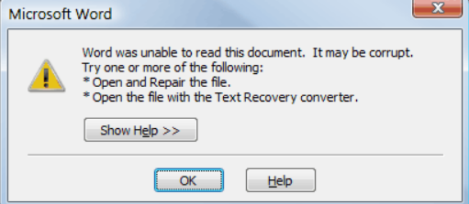
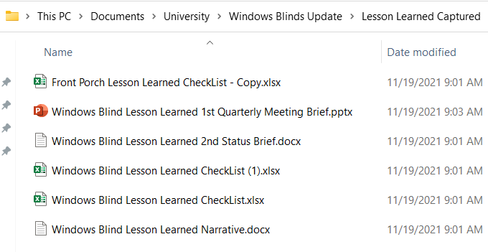
Improve from
Storage Amount
Corrupt files
Relationship between documents and files
Consolidation
21
Notes:
In consolidation:
We don’t need to worry about hard drive space limitations. Or the need to request more space if a drive is full.
Files can get often corrupted by the computer:
Shutdown, battery dies, restart, bad HDD, computer fried, etc.
Transferring files and not properly unplugging them.
Files that live in a project folder might have multiple files not associated with the project, it might be a copy of templates and later it doesn’t get cleanout or removed.

Slide 23
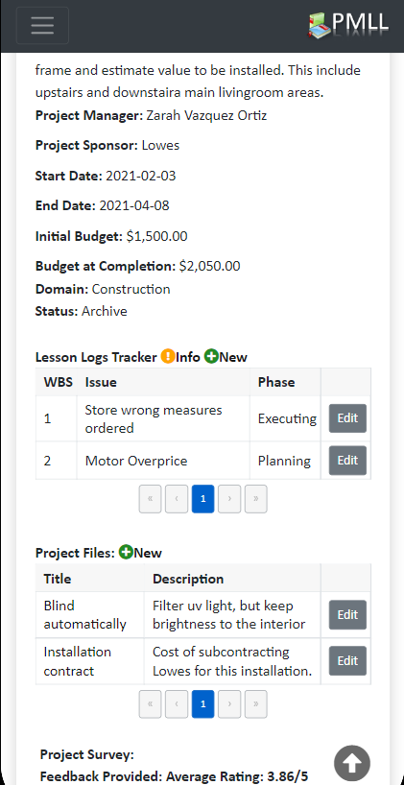
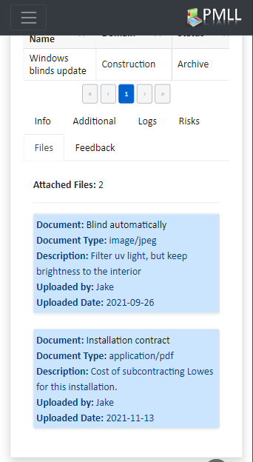
New feature
Integrity of files
One place for your search
Uniformity with date and logged by
Unlimited hosting space
Consolidation
22
Notes:
Files will be in the same place stored based on project number (When a project gets created it will assign a numeric value)
One system (web application) that you need to search for.
No multiple folders.
No multiple external drives or other computers.
All data capture will be formatted the same way on the same unique inputting the data to the web application.
Unlimited space.
No worry about if there is enough space.
The database can hold up to 1 GB of space for metadata. This can be expanded by service provided if needed.

Slide 24
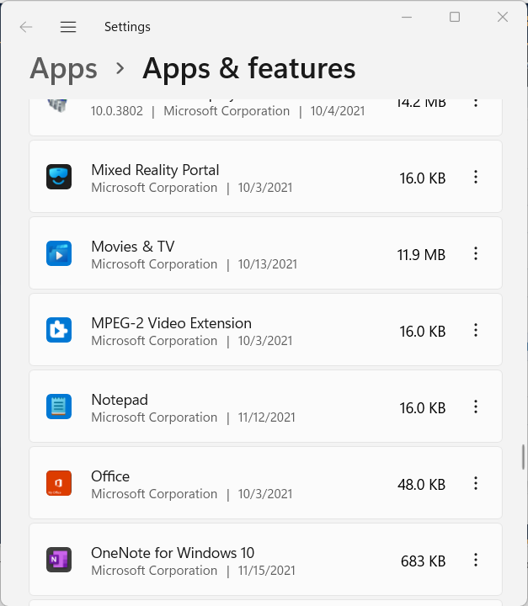
Improve from
Request IT to install app
Save/Print file to be shared
No cloud services
File extension compatibility
Web-base application, Accessibility & Flexibility
23
Notes:
Most of the time the user needs to submit a work order so the IT team can remotely or physically install the application requested in the case you are using a work computer.
Shared or export files to be transferred need a form of storage. This could be an external drive, file system, Printing, or sending by email.
Not everyone uses the same cloud services; some might need to go and request that cloud service.
Depending on the Operative system used, when files get saved those file formats might not be recognized by the other user system.

Slide 25
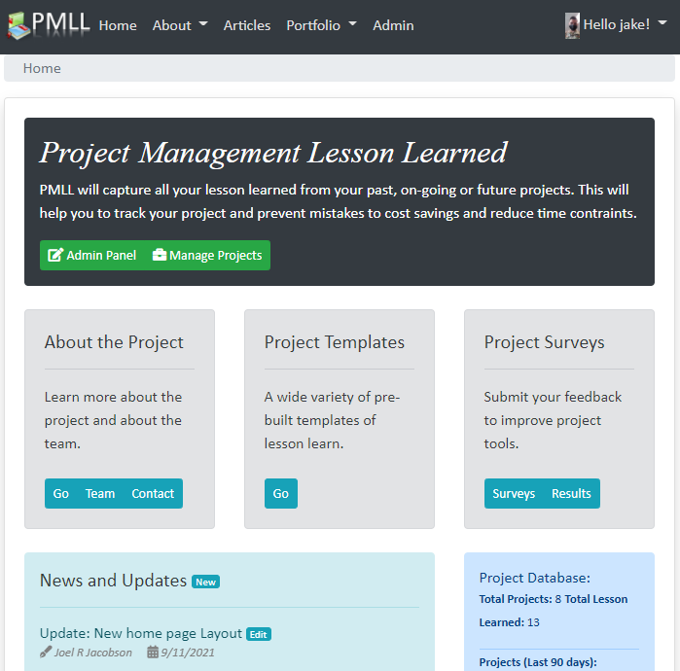
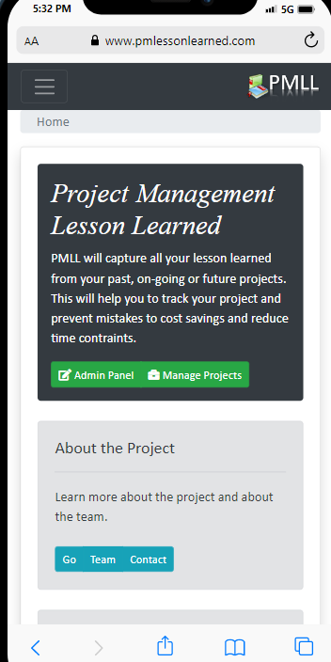
New feature
No Installation
Any Operative System
Mobile device with Internet Capability
Any Browser
Web-base application Accessibility & Flexibility
24
Notes:
Web-Based:
No Physical Installation is required to your computer hard drive.
Any Common OS compatible as: Microsoft, Apple, Chrome, Linux, and Other.
Accessibility & Flexibility:
Any Mobile device is compatible.
Any Browser version is compatible.

Slide 26
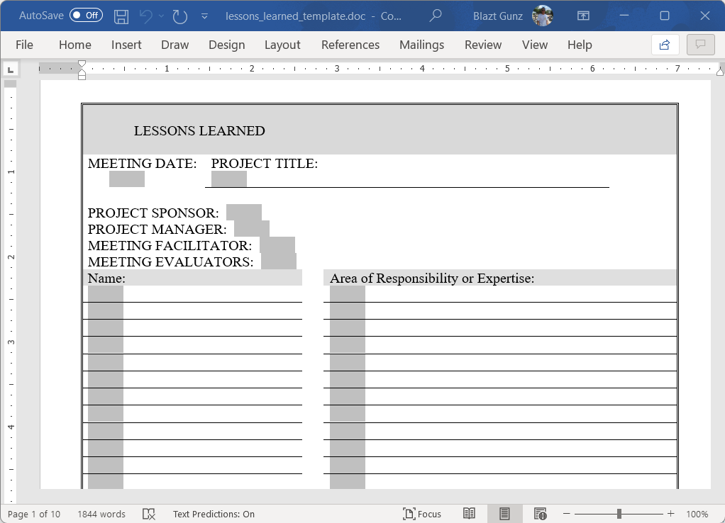
Improve from
Location provided consistency.
Tailored to the project need.
Time consumption in formatting.
Fixed field.
Lessons Learned Templates
25
Notes:
Templates usage:
Searching online takes time for the appropriate template.
Port over one application to another application.
Time consumption to tailor unformatted templates to your organization's needs.
Fixed field locked by the owner of the template.

Slide 27
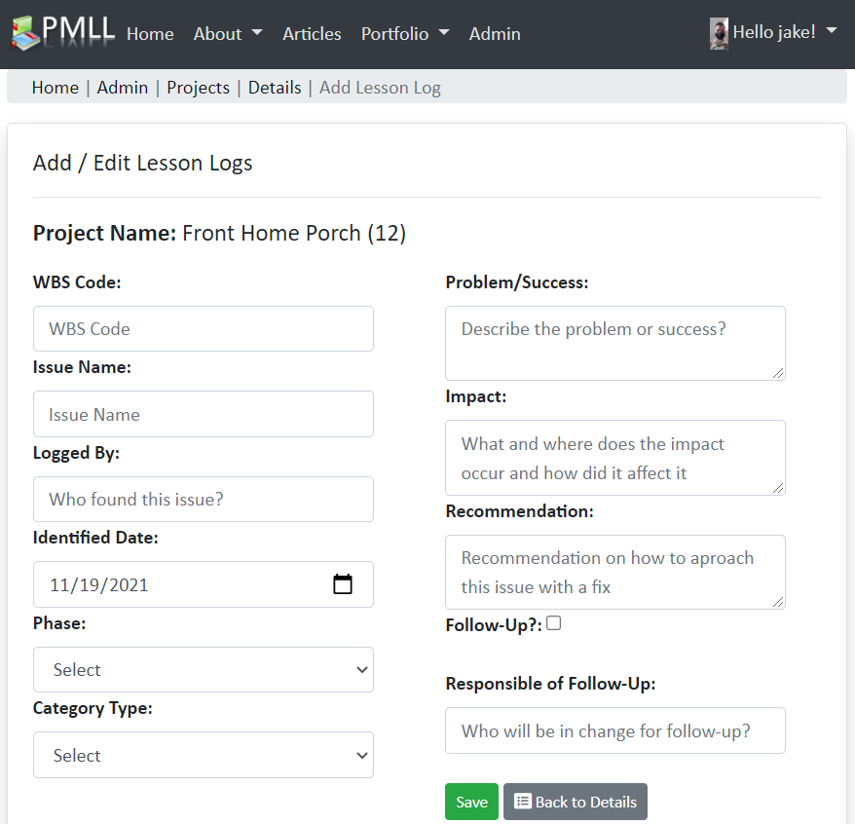
New feature
Uniformity.
Minimum required field.
Guideline to complete a lesson learned log.
Lessons Learned Templates
26
Notes:
Templates usage.
The same format across all lessons learned collected.
Validation of required field before saving.
Brief details to guide you on filling each area.

Slide 28
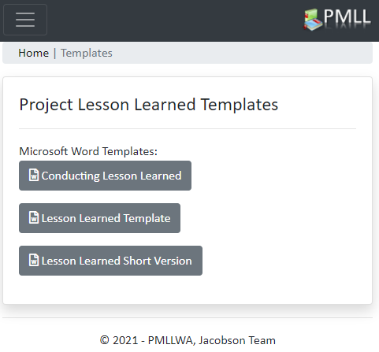
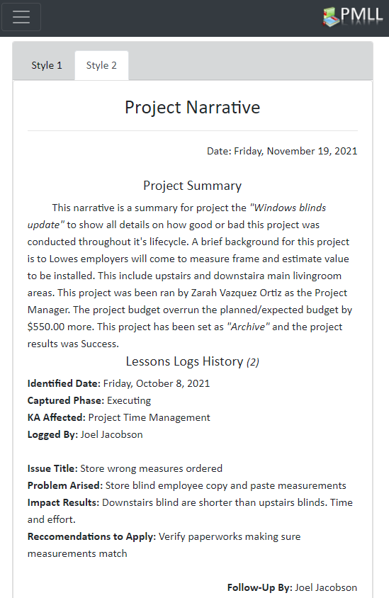
New feature
Printable or exportable.
Narrative Version.
Default templates.
Lessons Learned Templates
27
Notes:
Print the data projected on the screen or export the data if you want to bring it into a word document.
The project narrative provided 2 types of display.
Provide default templates for easy start off on writing lessons learned documentations.

Slide 29
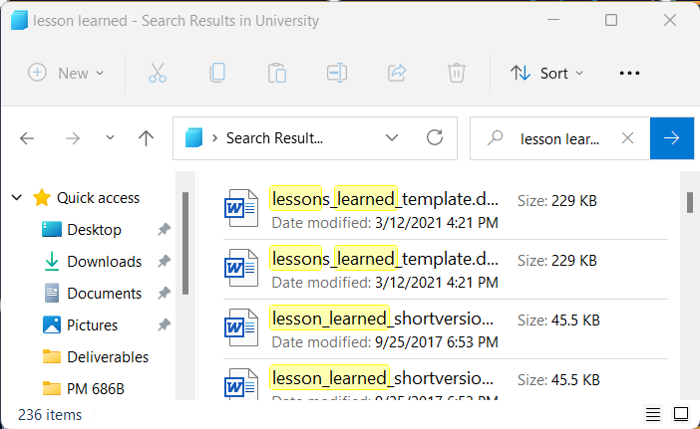
Improve from
Searching on a parent folder by the keyword
Multiples copies
Navigation – Friendly user?
Experience using searching tool?
Search Tools
28
Notes:
Searching files:
Can be tedious on finding the correct file you are looking for.
You might have multiples copies of the same file.
Searching for a specific lesson learned input won’t allow to search inside each file unless you open the file.
All Operative system behave differently when searching on the system explorer.

Slide 30
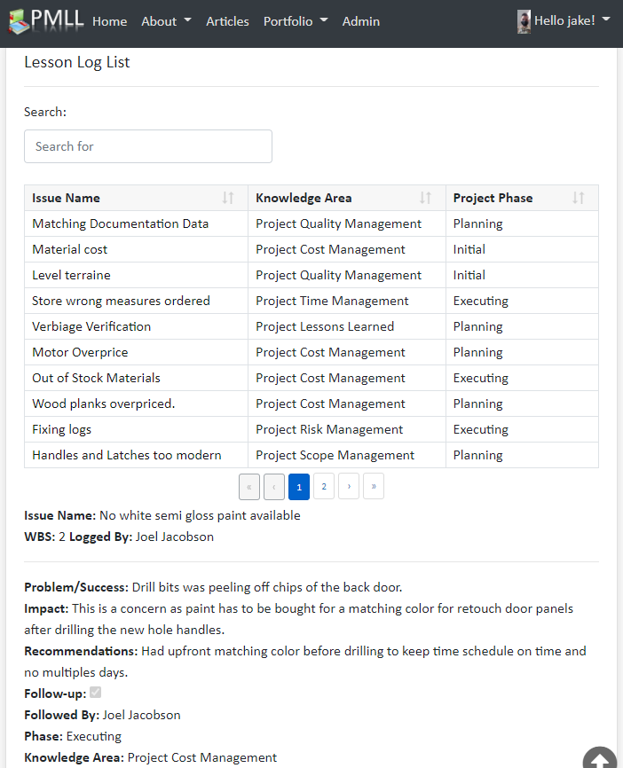
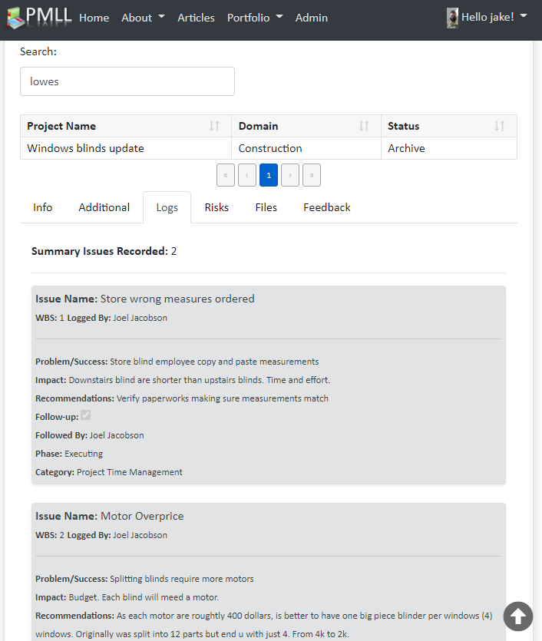
New feature
Search any content within a project
Search any lesson learned within any project, domain, knowledge area, phases and lesson title
Clickable for expanded details
Search Tools
29
Notes:
Searching files:
Filtering and sorting criteria for projects and lessons learned.
Using any keyword on a given project and lesson learned to bring up its metadata.
No need to open a file it will provide you with multiple tabs with more details of the project and related lessons learned.

Slide 31
06
Success Criteria
30

Slide 32
Success Criteria
Professional Domain Name http://pmlessonlearned.com
Functional Lesson Learned Template
Hosting file system & database storage
Friendly Layout design with navigation
Secure Measures with login access
Contact Form for support needed
Manual for users on how to use the web app
31
Notes:
Product Success Factor is explicitly based on all review analysis and survey results.

Slide 33
07
Recommendations
32

Slide 34
Recommendations
Stakeholder Involvement
Survey to Stakeholder
Explorer other programming languages
Visual Basic, python, C or C++
Project Expansion
Risk Identification
Budget: Services/Systems
33
Notes:
Stakeholder Involvement:
Future Recommendation is to include closely all stakeholders to provide to the project what success criteria they would like to see from the final deliverables. Schedule overload kept me putting aside all communication with stakeholders.
Survey to stakeholders:
Stakeholders approved validation criteria of survey questions. Stakeholder was not included as part of the data analysis from the survey’s results. A future recommendation is to send the same survey to my stakeholder, so they have a grasp of my hypothesis question of why and what is my focus to resolve the issue with the lesson learned not being properly transferred into new projects.
Explorer other programming languages:
Maybe I picked a complex languages to code with, and I could go to the route of creating a standalone application for the computer rather than going over online services. That will possibly shorten down the planning and execution phase.
Project Expansion:
A future recommendation is to include a risk identification section in the web app.
Project within development first version should be locally installed and ran from computer machine instead of paying 3 years of services.

Slide 35
08
Lessons Learned
34

Slide 36
Lesson Learned
Project Lesson Learned:
Measuring the complexity of the Project I picked.
Files Lesson Learned:
The project had too many copies of files of the old and new revisions. Cleanup needed.
Resources Lesson Learned:
Use of additional manpower during the execution phase.
Risks Lesson Learned:
There should be a deeper analysis of each work packages and tools to be used.
Deliverables Lesson Learned:
Some featured for the web application was not expected to be complex during project planning.
Schedule
Lesson Learned:
The project schedule was at a halt during the summer timeframe, should use those months.
System Lesson Learned:
Proper need of what type of computer system to use.
Research Paper Lesson Learned:
Rework of PMP and documents files.
35

Slide 37
09
Conclusion
36

Slide 38
Conclusion
Project Overview
Scope
Knowledge Areas
Research
Product Results
Recommendations
Lesson Learned
37
Notes:
Project Overview:
Why this type of project.
What was the problem, how did I resolve this problem.
Project Scope:
Deliverables produced: Security, Consolidation, Templates, Web-based, Accessibility
Knowledge Areas:
Schedule, Scope, Cost & Risk Management
Research:
What is out there that provide improvement. How it will fit this new tool with users. What are a baseline to start with.
Product Results:
Short-time refine for personal needs. Long-term commercially used.
Recommendations:
What approach this project can be improved. Fit the general public needs, make it public free for research purpose and enhance the tools.
Conclusion:
Small video to present a visual drive-through to the areas of interest in the application.

Slide 39
THANKS!
Any questions regards to the project presentation?
38
Notes:
Acknowledgement:
Professors: Ms. LuAnn Piccard, Mr. Roger Hull
Editors Assistance: Zarah Vazquez, Justin Holvoet
Programming Mentor: Sean Edwards

